Slide 1
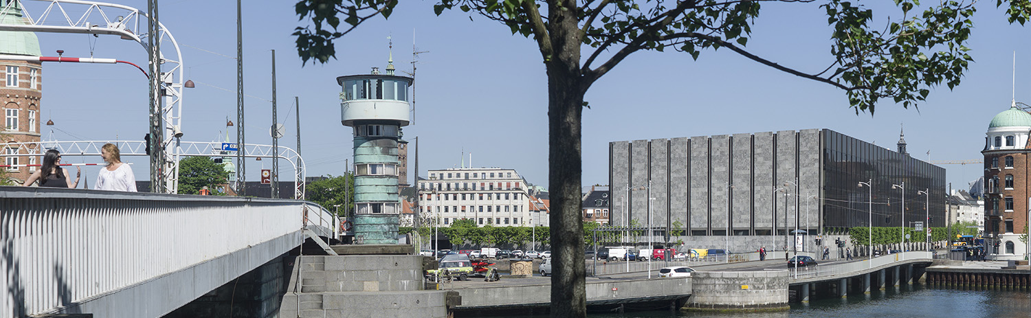
Central bank digital currency in Denmark?
Morten Spange, Senior Adviser
The views expressed in this presentation are those of the presenter and do not necessarily reflect those of Danmarks Nationalbank.

Slide 2
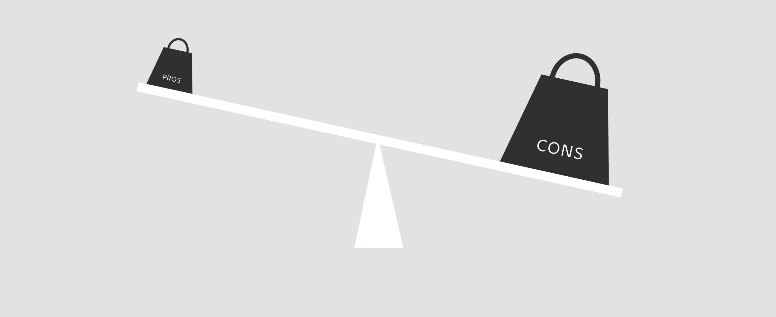
Central bank digital currency
No benefit for Denmark

Slide 3
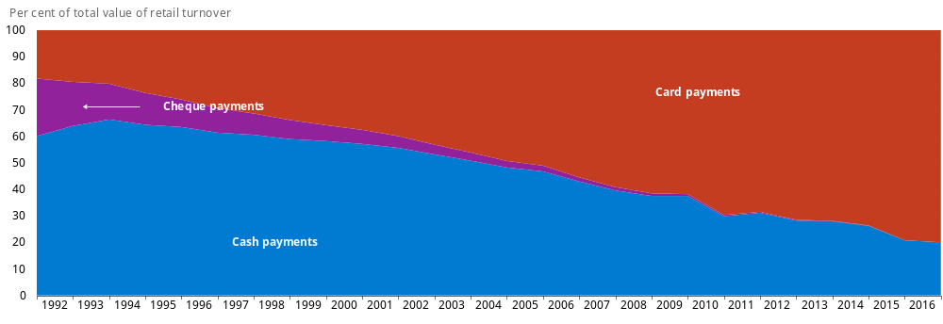
Sharp decline in the use of cash
Source: Danmarks Statistik, Danmarks Nationalbank, Finansrådet, Nets and own computations.

Slide 4
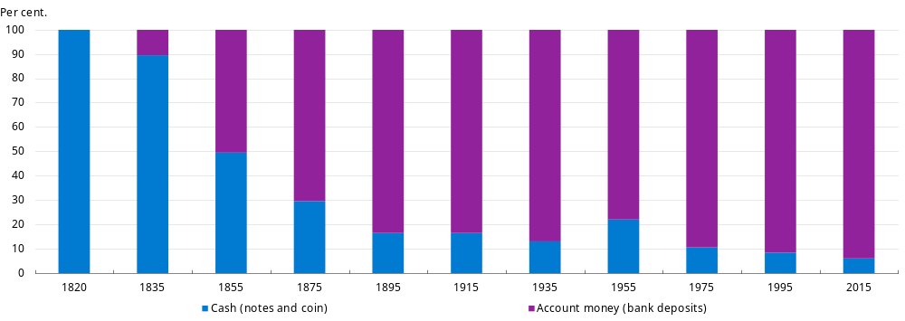
Most money are bank deposits – as was the case 100 years ago
Source: Kim Abildgren and Danmarks Nationalbank.

Slide 5
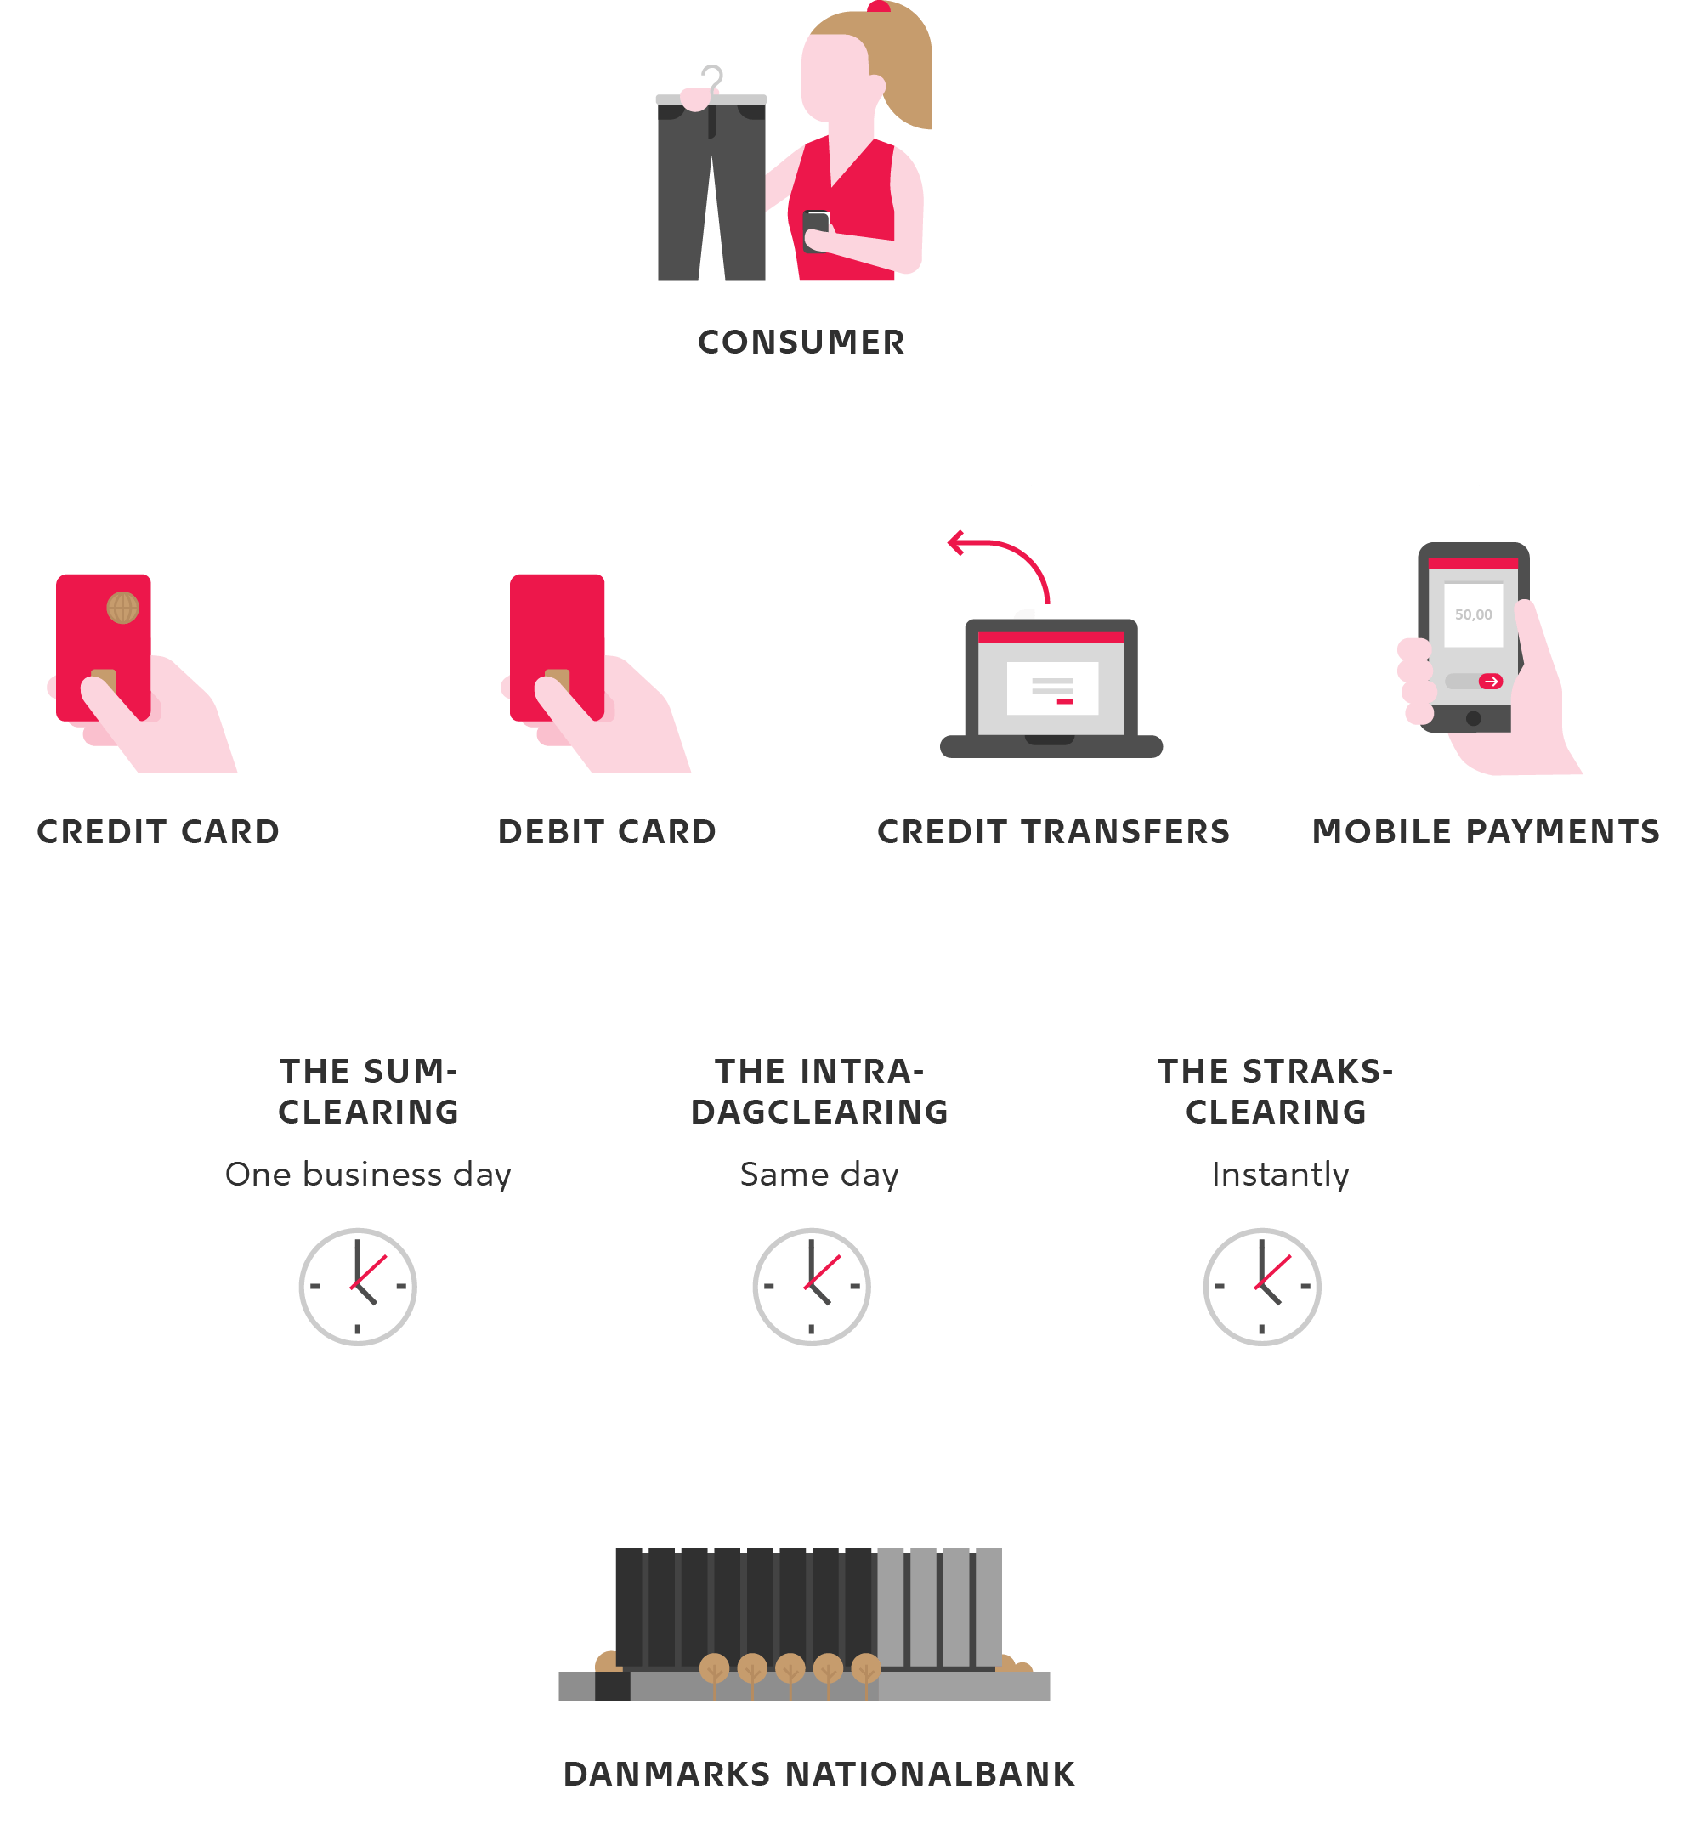
Efficient payment system

Slide 6

Right to a risk free financial asset?
Cash
Central bank digital currency

Slide 7
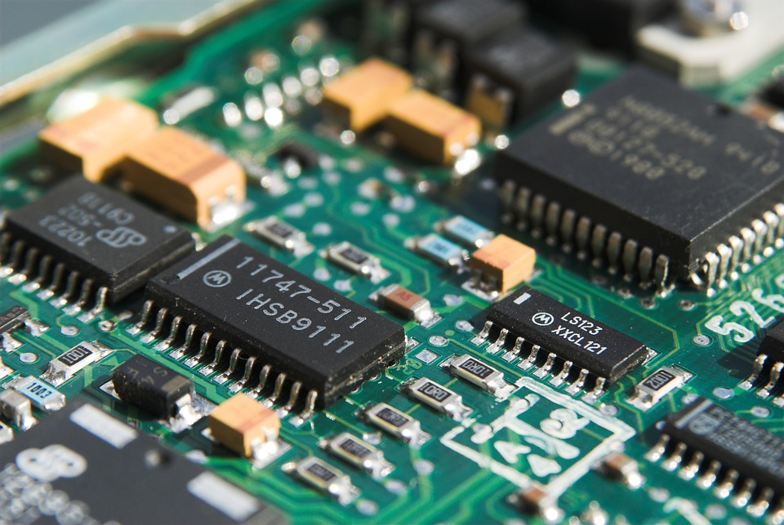
CBDC as a back up?
Grafer:
Grafer laves i Excel.
Se vejledning her:
http://natinfo/Videncenter/
DesignOgGrafik/
default.aspx

Slide 8

Systemic bank runs

Slide 9
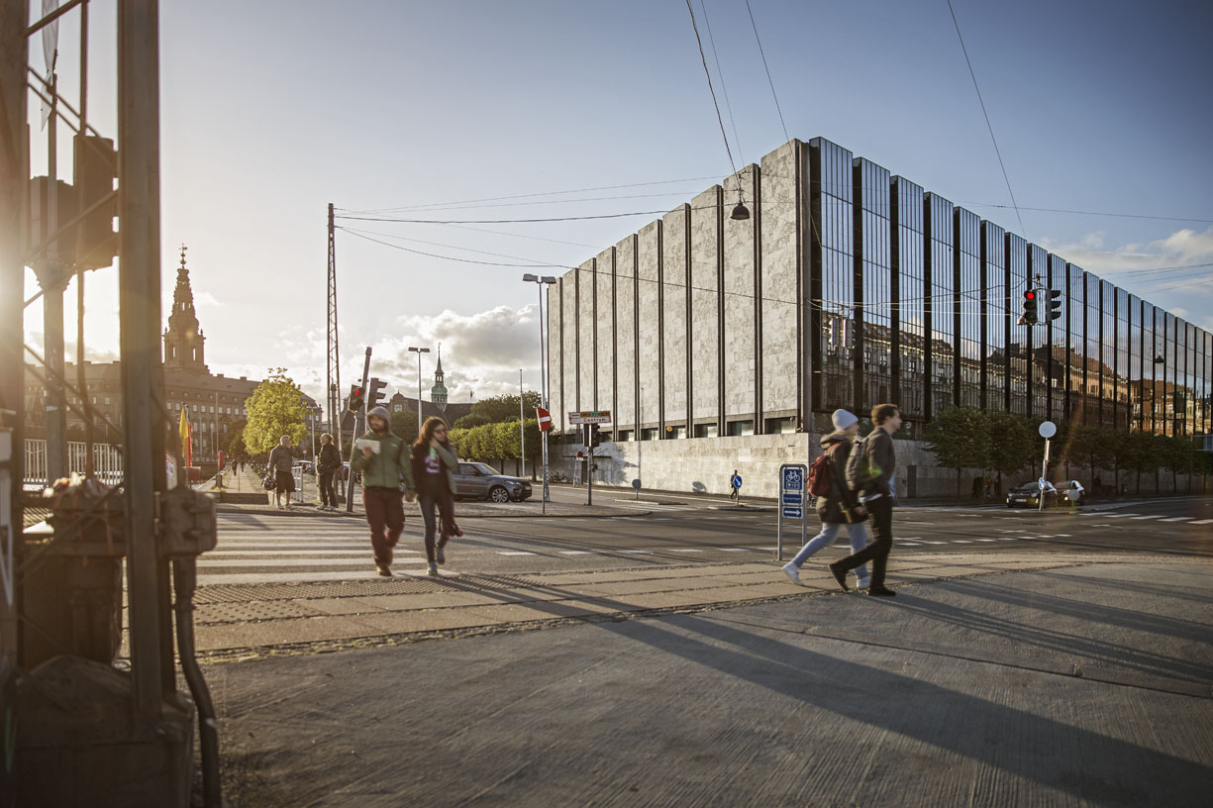
Going from being banker to the banks to being banker to the public is a fundamental change

Slide 10

A matter of identity?

