Slide 1
Consequences and conundrums of Sovereign Money
15 June 2019
The Future of Money
Stockholm, Sweden
PhD Patrizio Lainà
University of Helsinki

Slide 2
Content
Introduction
Historical examples
Normative evaluation
Results from an economic model
Conclusions

Slide 3
Introduction

Slide 4
Research questions
Has Sovereign Money (SM) been implemented in the past? If so, what were the consequences?
What are the advantages and shortcomings of SM?
How could the economic consequences of SM be modelled?

Slide 5
Full-Reserve Banking (FRB) used as an umbrella term
Different types of FRB:
 | Pure Commodity Standard | Sovereign Money (SM) | Chicago Plan | Deposited Currency | Narrow Banking | Limited Purpose Banking
Features | All money, including bank deposits, backed by a commodity such as gold (in all other types backed by government money). | All demand deposits held at central bank. Deposit banks can make loans only by attracting savings or using own capital. | Deposit banks provide only payments services and cannot make loans. | Full-reserve requirement applied only to certain deposits. Other (not fully-backed) deposits not guaranteed. Individuals choose which type of deposits to hold. | Banks’ assets restricted to those considered ‘safe’ by some standards. | Banks become unleveraged mutual funds. Banks’ liabilities restricted to equity.
Notes | Associated with Austrian school. | Associated with Positive Money, New Economics Foundation and ecological economics. | Associated with ‘old’ Chicago school and monetarism. | For example, postal saving system or central bank accounts for the general public. | Less restrictive proposals not counted as FRB. | Instead of banks, all risks are born by investors.
Proposals | Ricardo (1824), Mises (1912), Hayek (1937), Rothbard (1962), Huerta de Soto (2009) | Soddy (1926; 1934), Currie (1934; 2004), Daly (1980; 2013), Rowbotham (1998), Huber and Robertson (2000), Yamaguchi (2010; 2011; 2014), Jackson and Dyson (2012), Kolehmainen et al (2013), Farley et al (2013), Wolf (2014a; 2014b), Lainà (2015b), Green Party UK (2015), Sigurjonsson (2015) | Knight et al (1933), Simons et al (1933), Fisher (1935), Douglas et al (1939), Simons (1948), Friedman (1948; 1960; 1969), Benes and Kumhof (2012; 2013), Prescott and Wessel (2016) | Tobin (1985; 1987), Jessup and Bochnak (1992), Gruen (2014), Lainà (2015a), Barrdear and Kumhof (2016) | Kareken (1986), Litan (1987), Spong (1996), De Grauwe (2008a), Kay (2009), Phillips and Roselli (2009), Flaschel et al (2010), Chiarella et al (2011), King (2016), Stiglitz (2016) | Pollock (1993), Kotlikoff (2010), Cochrane (2014)

Slide 6
Historical examples

Slide 7
FRB experimented in the 19th century
In the UK, the Bank Charter Act of 1844 implemented FRB
  Required that bank-issued notes (which were the prevailing means of payment) should be fully-backed by government money or gold
In the US, the National Acts of 1863 and 1864 implemented FRB
Macroeconomic indicators continued their previous paths or pointed upwards after the experiments
FRB requirement did not cover bank deposits which quickly became the dominant means of payment
Foundations of the monetary system unchanged ever since

Slide 8
FRB did not lead to economic collapse after implementation in the UK
Source: Bank of England OBRA dataset "A Millennium of UK Data“ (2017)

Slide 9
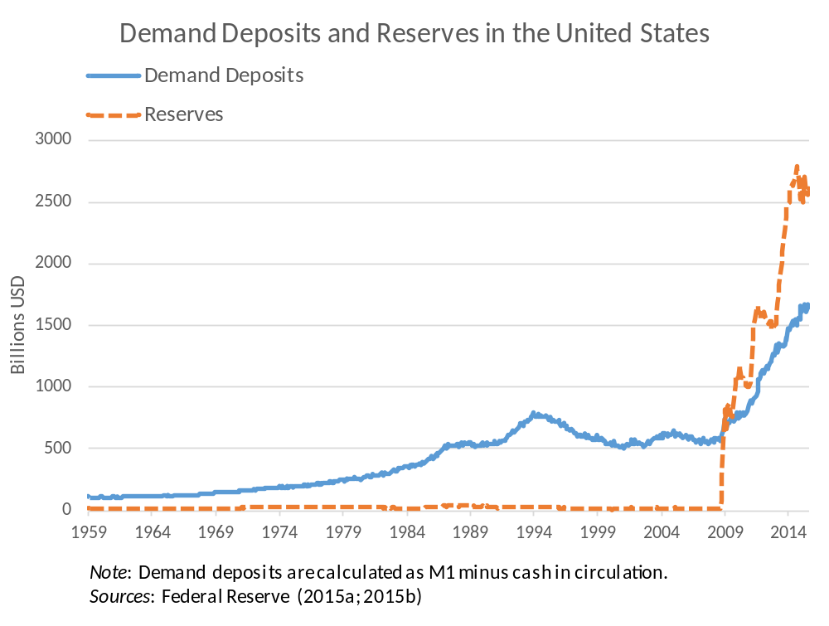
U.S. runs a FRB system today… but only on aggregate level

Slide 10
Normative evaluation

Slide 11
Democracy
Support in surveys (+)
Expands democratic sphere (+)
Seigniorage revenue (+)
Government not necessarily democratic (-)
Corruption and abuse (-)
→ Positive impact

Slide 12
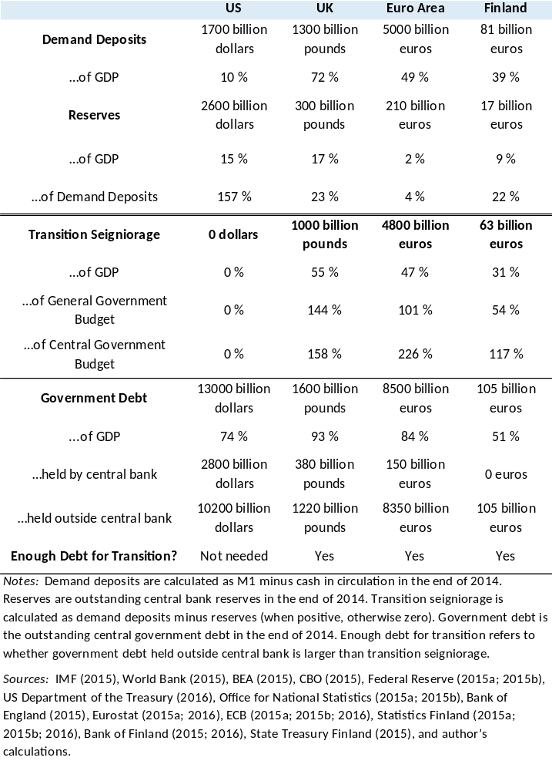
One-shot seigniorage revenue from transition

Slide 13
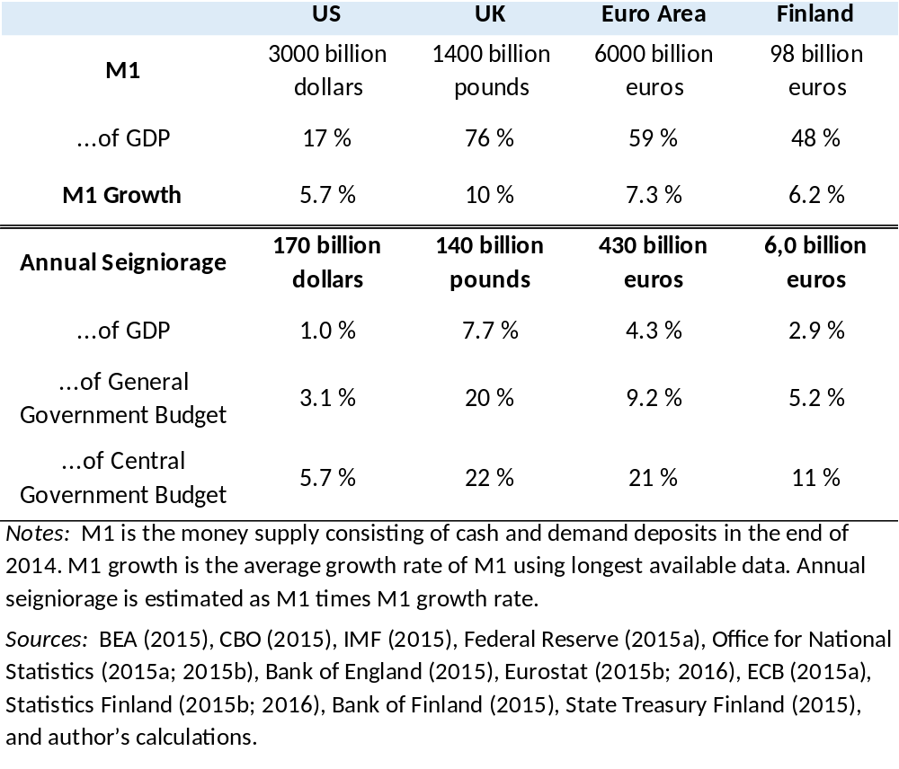
Annual seigniorage revenue
Money supply would grow at the same rate, but instead of bank loans it would come into existence through government spending

Slide 14
Economic stability
Payment system secured (+)
Occurrence and severity of financial crises reduced (+)
Business cycle fluctuations tamed (+)
No bank bailouts and deposit insurance (+)
Risks and rewards re-aligned (+)
Near-monies undermine SM (-)
Credit crunches and volatile interest rates (-)
Inflationary or deflationary (-)
→ Positive impact

Slide 15
Social equality
New money distributed evenly (+)
Tax payers need not guarantee banks (+)
No risk-free returns (+)
No effect on income inequality (-)
Tighter credit affects mostly least well-off (-)
Higher interest rates for borrowers (-)
→ Slightly positive impact

Slide 16
Ecological sustainability
New money creation for ecological production (+)
Savers favour green investment (+)
Growth imperative removed (+)
No real growth imperative in the current system (-)
Investment decisions not affected by monetary system (-)
→ No impact

Slide 17
International aspects (the big conundrum!)
How would the international political and economic community react?
Practically no research available
Depends on beliefs!
International political community might be receptive?
  E.g. IMF has welcomed CBDC
  On the other hand, might be seen as a challanger of the current monetary system
International economic community could be hostile?
  Might cause (un)justified fears of nationalisation among investors
  On the other hand, could be seen as a safe-haven

Slide 18
Economic model

Slide 19
Stock-Flow Consistent model of FRB
FRB never before modelled in a SFC framework
Godley and Lavoie’s (2012) model INSOUT modified
Basically, a combination of Sovereign Money (banks can make loans) and Chicago Plan (all deposits fully backed by central bank reserves)
Post-Keynesian model: behavior guided by norms rather than constrained optimization
5 sectors: firms, households, government, banks and central bank
80 equations, 74 enter the model
Published in Cambridge Journal of Economics

Slide 20
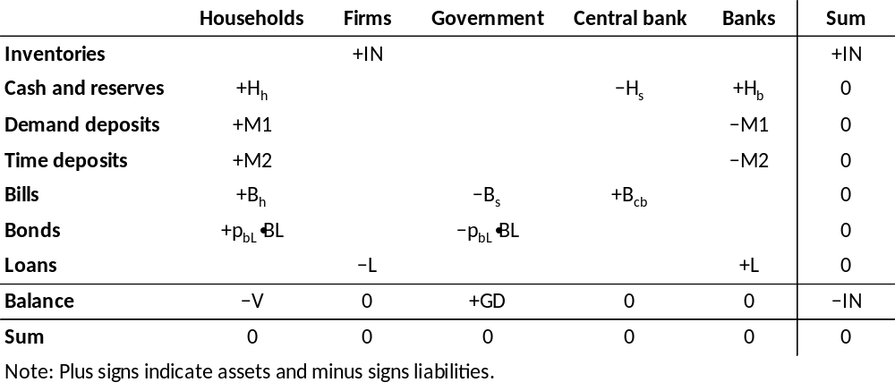
Balance sheet matrix

Slide 21
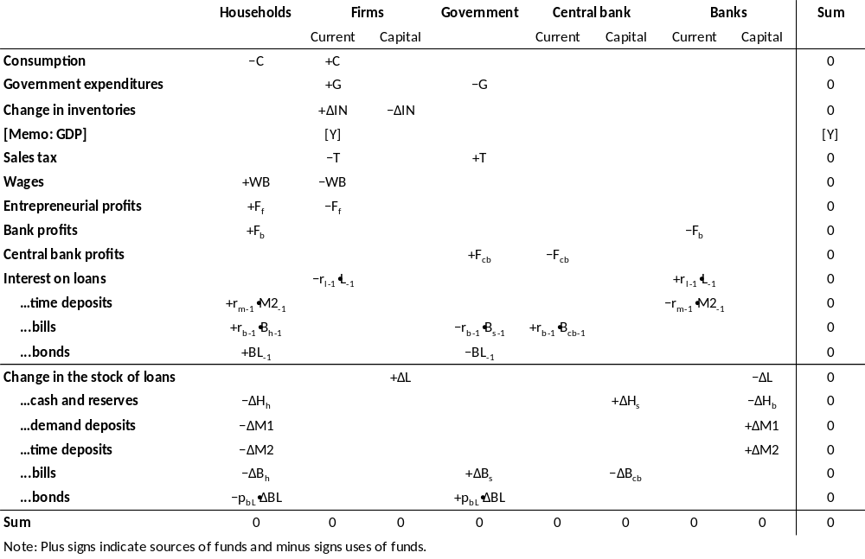
Transaction-flow matrix of SFC model

Slide 22
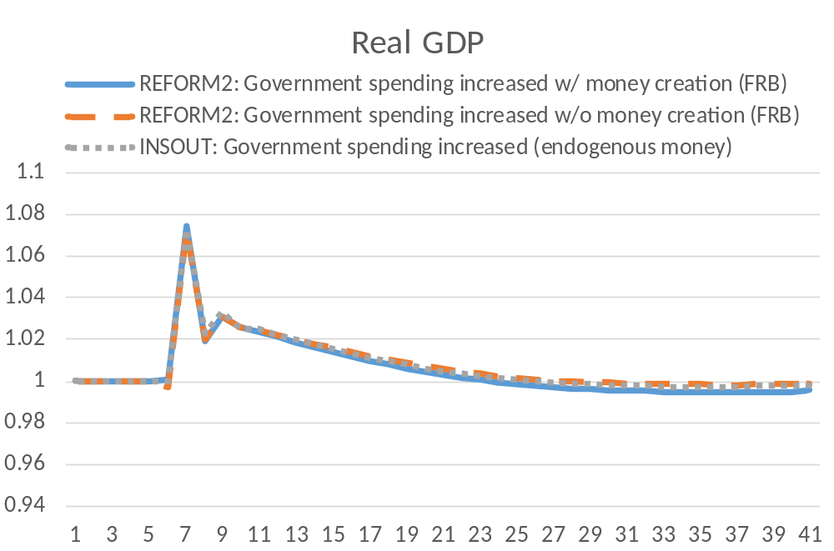
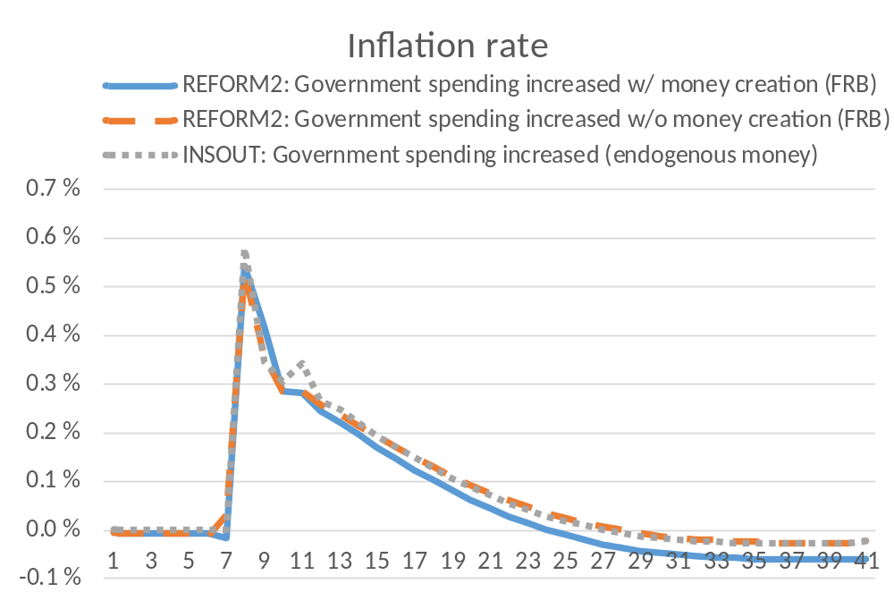
No differences in output and inflation

Slide 23
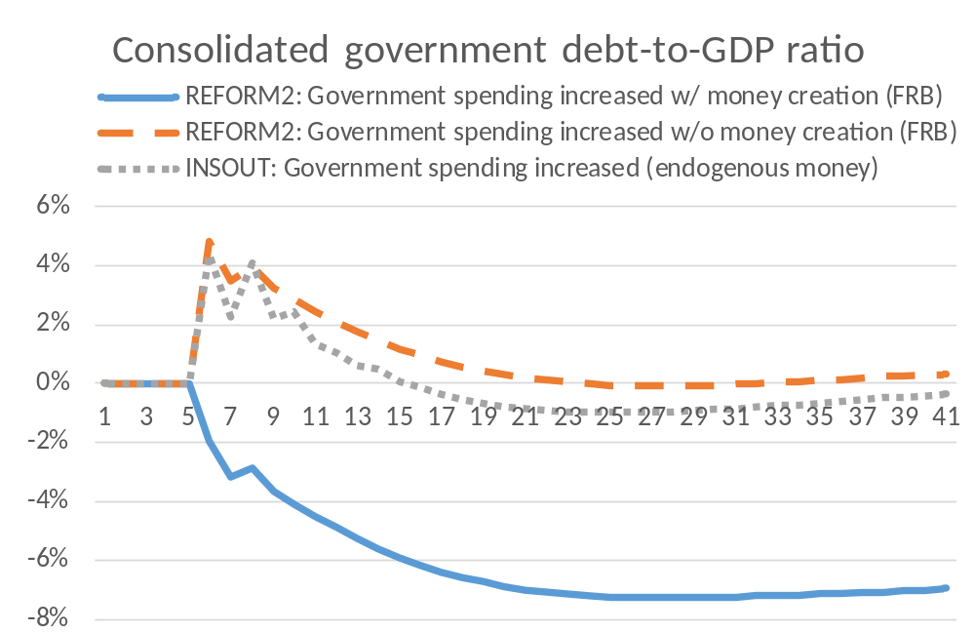
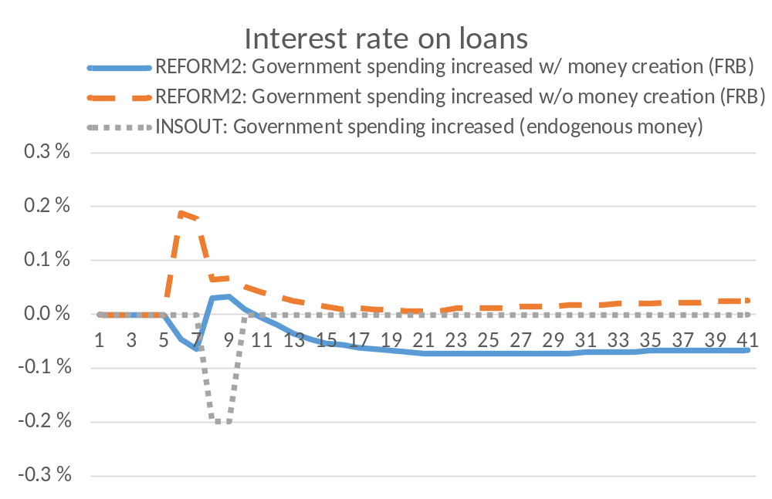
Fiscal space of the government increases under FRB

Slide 24
Findings from the economic model
Output, employment and inflation evolve very similarly under FRB and the current monetary system
Fiscal space of the government increases under FRB
Smooth and relatively small changes in interest rates
Money creation in a FRB system through government spending, tax cuts or citizen’s dividend roughly same impact
However, money creation through quantitative easing (repayment of government debt) affects only monetary aggregates but not the real economy
Credit crunches possible but rare

Slide 25
Conclusions

Slide 26
Conclusions
FRB experimented in the 19th century with no adverse economic developments → at least economic collapse highly unlikely
Positive impact on democracy and economic stability
Slightly positive impact on social equality
No impact on ecological sustainability
Success depends on how the international political and economic community would react
Implementation needed for more reliable research results

