Slide 1
The Debt and Credit Trap
www.patreon.com/profstevekeen
www.profstevekeen.com

Slide 2
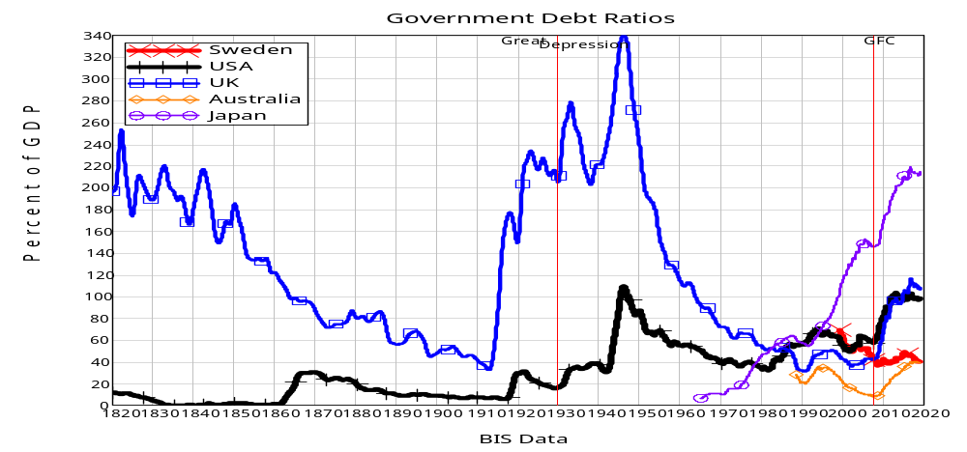
The Debt and Credit Trap
Most public discussion is about Government Debt
It’s high, but it’s been much higher in the past…

Slide 3
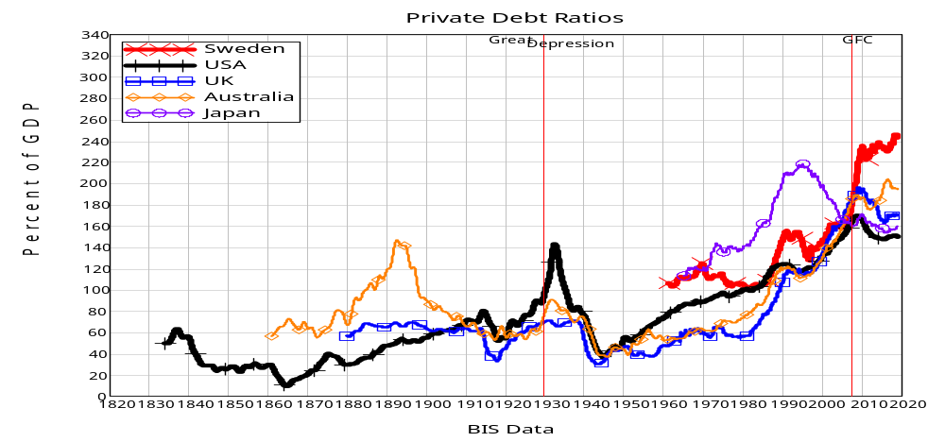
The Debt and Credit Trap
What is at an all-time high is private debt…

Slide 4
The Debt and Credit Trap
Why don’t we talk (much) about private debt?
Same reason Medievals didn’t talk about gravity: their priests taught them a false theory
  “The idea of debt-deflation … was less influential in academic circles, though, because of the counterargument that debt-deflation represented no more than a redistribution from one group (debtors) to another (creditors).
  Absent implausibly large differences in marginal spending propensities among the groups, it was suggested, pure redistributions should have no significant macro-economic effects.” (Bernanke, 2000, p. 24)
Banks as “Financial Intermediaries” in a “Loanable Funds” model
  “Think of it this way: when debt is rising, it’s not the economy as a whole borrowing more money.
  It is, rather, a case of less patient people—people who for whatever reason want to spend sooner rather than later—borrowing from more patient people.” (Krugman 2012, End this Depression Now!)

Slide 5
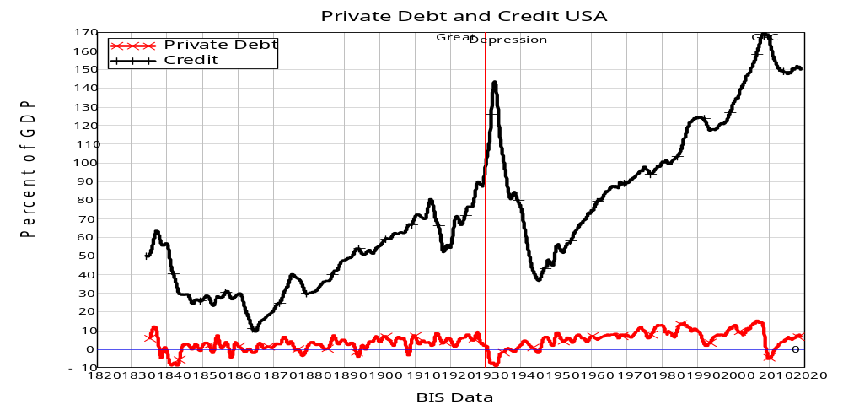
The Debt and Credit Trap
So mainstream (Neoclassical) economists (except Michael! ☺) ignore this data:
USA’s 3 biggest crises all had negative credit
Panic of 1837
Great Depression
Great Recession

Slide 6
The Debt and Credit Trap
After the crisis, Central Banks reject Loanable Funds/Money Multiplier models:
Bank of England 2014: “Rather than banks receiving deposits when households save and then lending them out, bank lending creates deposits.”
Bundesbank 2017: “It suffices to look at the creation of (book) money as a set of straightforward accounting entries to grasp that money and credit are created as the result of complex interactions between banks, non- banks and the central bank.
  “this refutes a popular misconception that banks act simply as intermediaries at the time of lending – i.e. that banks can only grant credit using funds placed with them previously as deposits by other customers.”
Bank of England 2014: “In normal times, the central bank does not fix the amount of money in circulation, nor is central bank money ‘multiplied up’ into more loans and deposits.”
Bundesbank 2017: “And a bank’s ability to grant loans and create money has nothing to do with whether it already has excess reserves or deposits at its disposal.”

Slide 7
The Debt and Credit Trap
What’s the macroeconomic impact of credit?
A logical analysis: derive relative impact from identity of Aggregate Demand & Supply
Divide economy into 3 sectors, where each sector spends on the other two
3x3 “Moore Table”: diagonal is expenditure (-), off-diagonal is income (+)
Each row must sum to zero: (Your) Expenditure IS (Someone Else’s) Income
Column sum can be non-zero: sectoral incomes can differ from expenditures
3 monetary arrangements
  “Say’s Law”: no lending possible
  “Loanable Funds”: lending between two sectors (along diagonal)
  “Bank Originated Money & Debt”: Bank (4th sector) lends to one sector
    Its Assets rise in tandem with new net lending

Slide 8
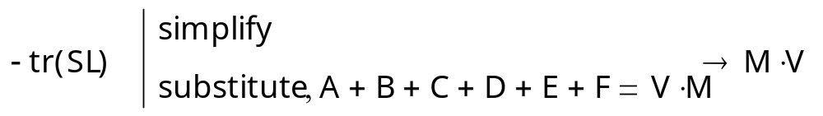
The Debt and Credit Trap
Firstly, “Say’s Law”: Expenditure only from existing money, no lending/borrowing
”Say’s Law” | Sector 1 | Sector 2 | Sector 3 | Sum
Sector 1 | -(A+B) | A | B | 0
Sector 2 | C | -(C+D) | D | 0
Sector 3 | E | F | -(E+F) | 0
Sum | (C+E)-(A+B) | (A+F)-(C+D) | (B+D)-(E+F) | 0
Aggregate Demand
Expenditure by sector 1
Income generated by sector 1’s expenditure
Income for sector 1
Effectively Friedman’s “Quantity theory of money”
  Aggregate Demand ≡ Aggregate Income = money times velocity of circulation

Slide 9
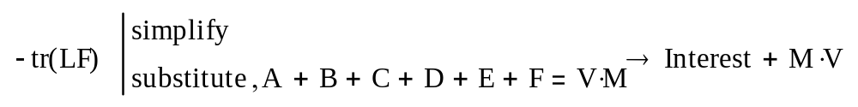
The Debt and Credit Trap
“Loanable Funds”
  Sector 2 lends to sector 1 (flow across diagonal of table)
  Sector 1 pays interest to sector 2
  Sector 1 spends on sector 3
Expenditure of credit
 | Sector 1 | Sector 2 | Sector 3 | Sum
Sector 1 | -(A+B+Credit +Interest) | A+Interest | B+Credit | 0
Sector 2 | C | -(C+D-Credit) | D-Credit | 0
Sector 3 | E | F | -(E+F) | 0
Sum | (C+E)-(A+B+Credit+Interest) | (A+F+Interest)-(C+D-Credit) | (B+D)-(E+F) | 0
Flow of credit
Credit cancels out
  IF loanable funds were true, THEN banking could be ignored in macroeconomics

Slide 10
The Debt and Credit Trap
“Bank Originated Money and Debt”: Bank lending (to sector 1) creates money
Sector 1 spends this money on sector 3
Creation of credit
Expenditure of credit
 | Assets | Liabilities (Change in Deposit Accounts) |  |  | Equity
 | ΔDebt | Sector 1 | Sector 2 | Sector 3 | Bank | Sum
Sector 1 | Credit | -(A + B + Credit + Interest) | A | B+Credit | Interest | 0
Sector 2 |  | C | -(C+D) | D |  | 0
Sector 3 |  | E | F | -(E+F) |  | 0
Bank |  | G | H | I | -(G+H+I)
Sum |  | (C+E+G)-(A+B+Credit + Interest) | (A+F+H)-(C+D) | (B+D+I+Credit)-(E+F) | Interest-(G+H+I) | 0
Credit (increase in Bank Liabilities) created by increase in debt (Bank assets)
Credit does not cancel out
  SINCE BOMD is true, THEN banking cannot be ignored in macroeconomics
  Credit is the most volatile component of aggregate demand and income

Slide 11
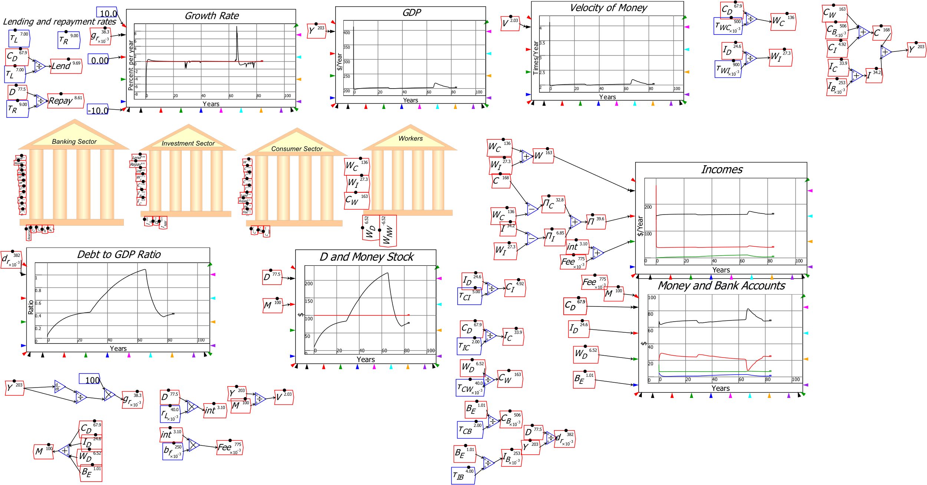

The Debt and Credit Trap
Illustrating this this in Minsky: system dynamics software supporting monetary modelling using double-entry bookkeeping…
Krugman & Eggertsson (2012 supplement) had Loanable Funds model
  “Patient” Consumer goods producing agent lends to “Impatient” Investment goods producing agent
  Bank charges “Intermediation Fee”
Huge changes in credit and debt
Trivial changes in DP

Slide 12
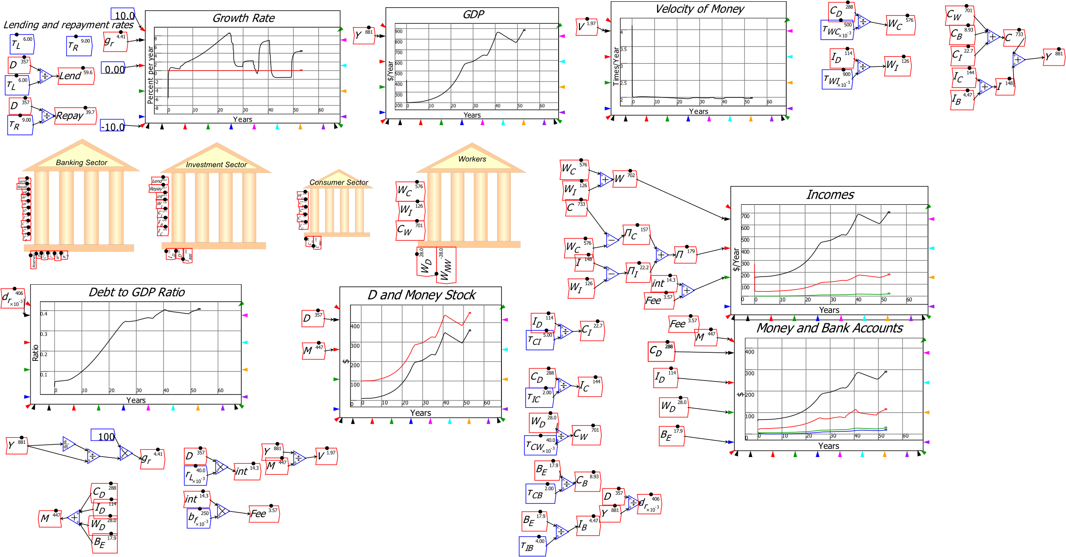

The Debt and Credit Trap
Easily modify it to BOMD…
Huge changes in credit and debt
Huge changes in GDP

Slide 13
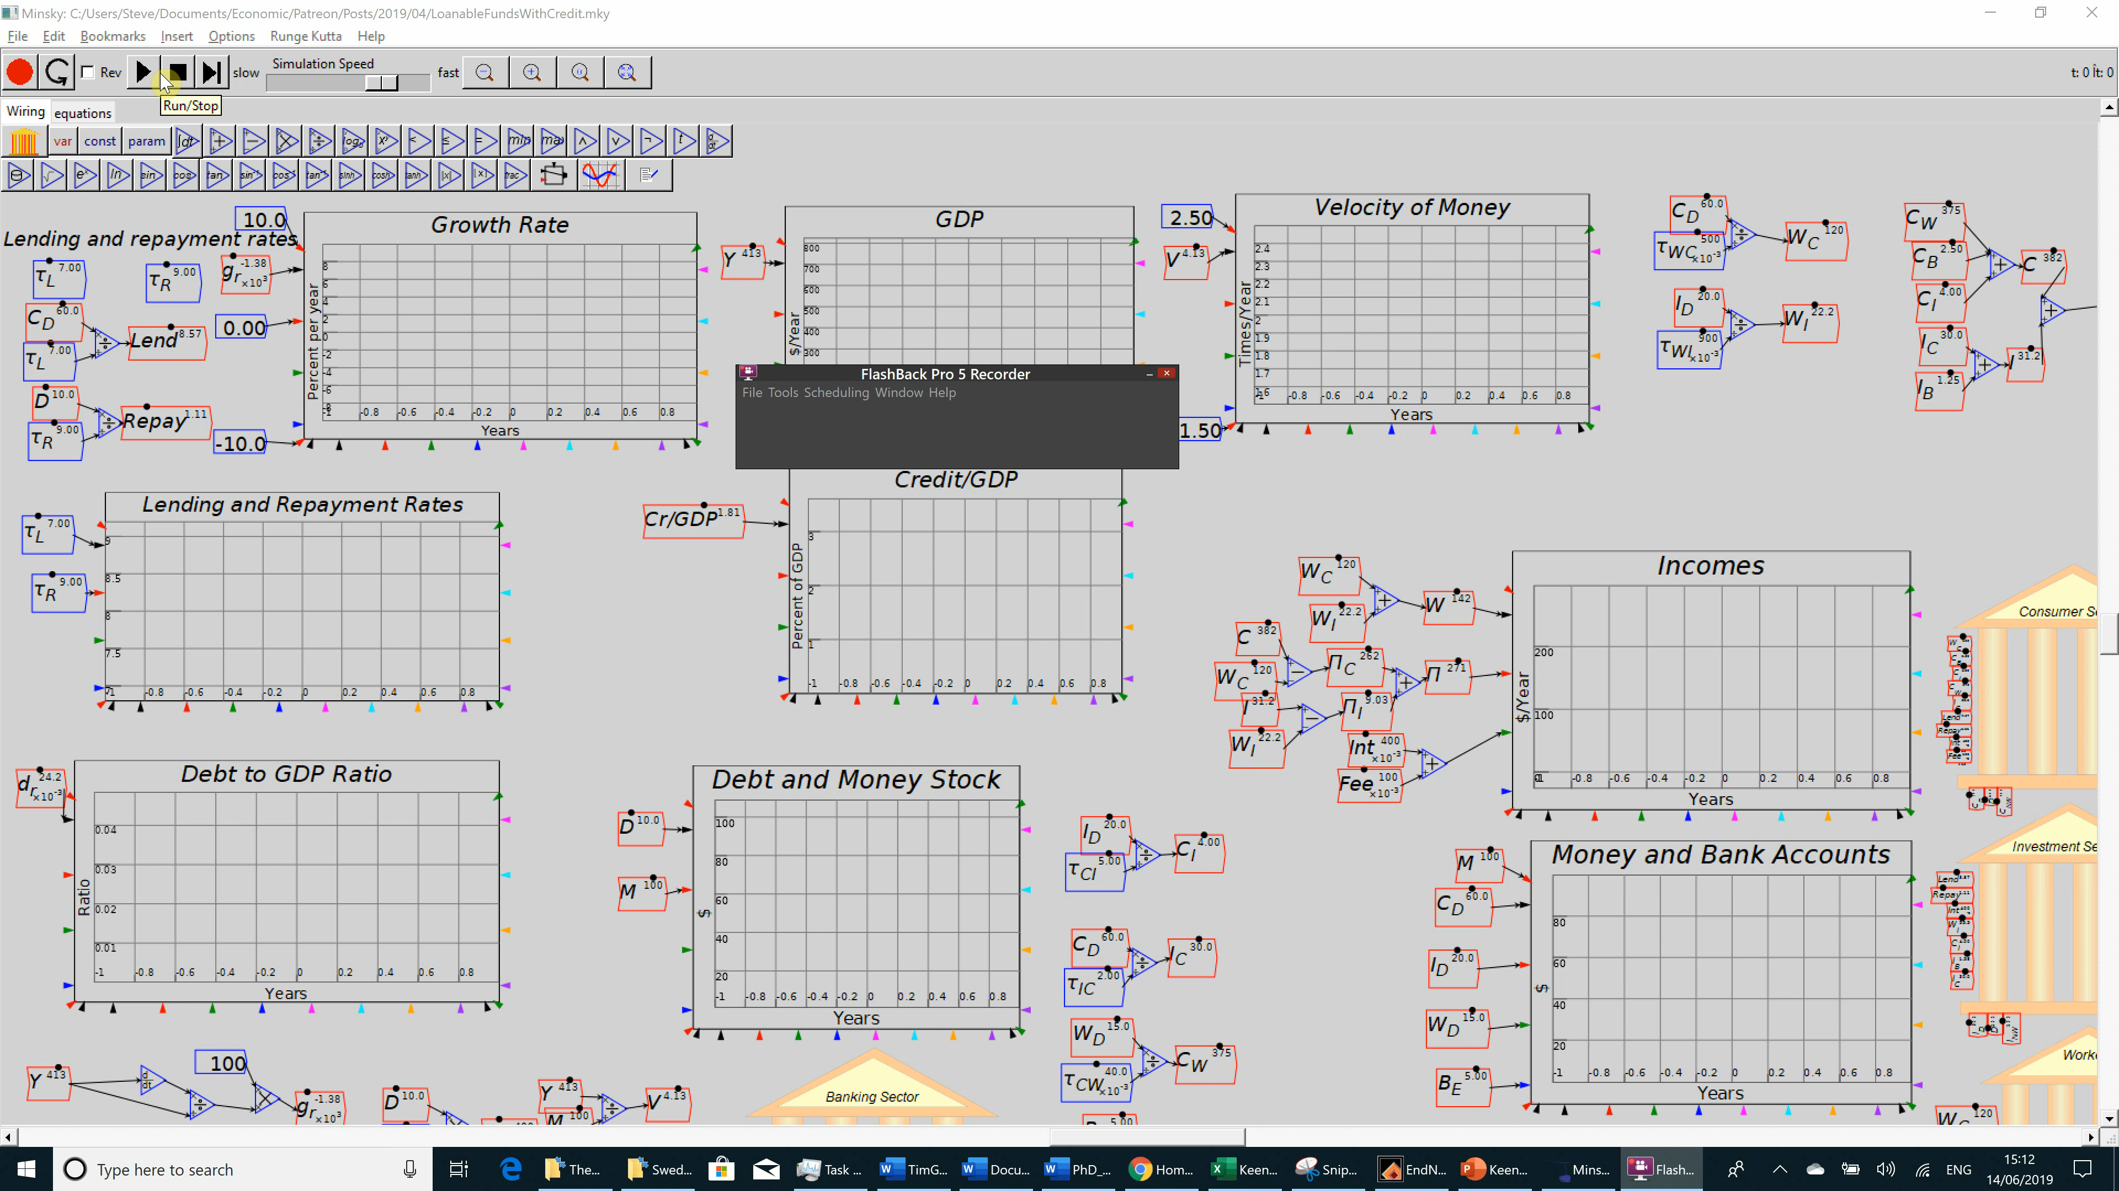
The Debt and Credit Trap
From Loanable Funds to Bank Originated Money and Debt (BOMD) in 2 minutes…

Slide 14
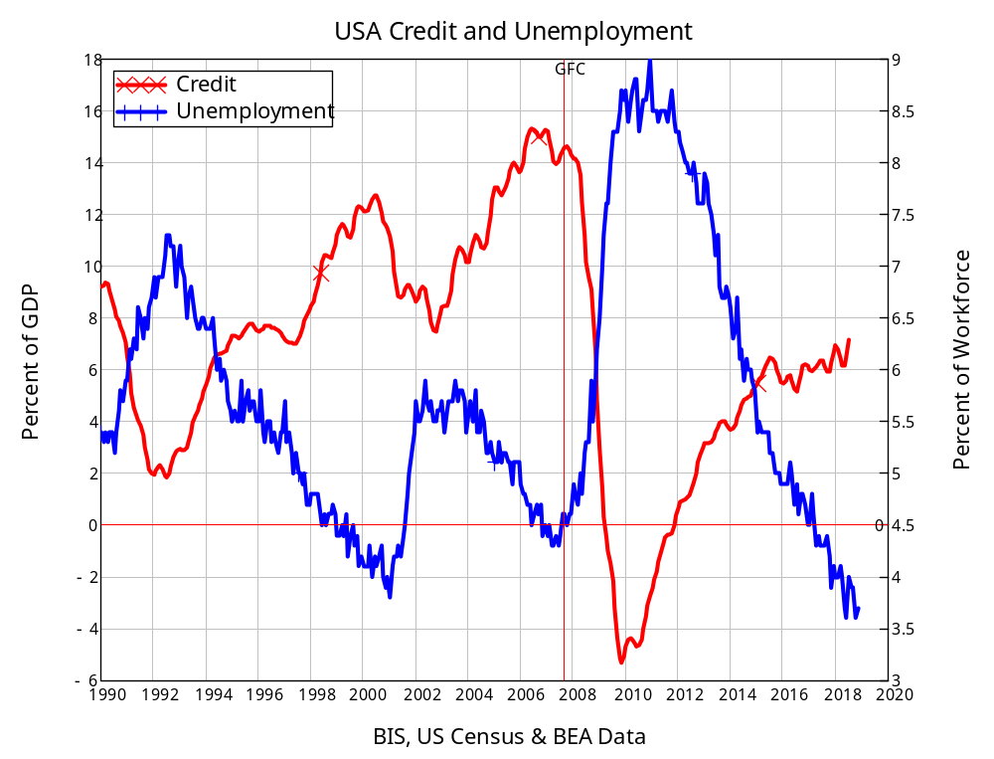
The Debt and Credit Trap
Correlation of credit with unemployment in the USA since 1990 is minus 0.85
Causation runs from credit to aggregate demand (as shown in Moore Table)
Similar results for all other countries in BIS database
  (Except Germany!
    Huge trade surplus plus government austerity
    Low/falling credit usage)

Slide 15
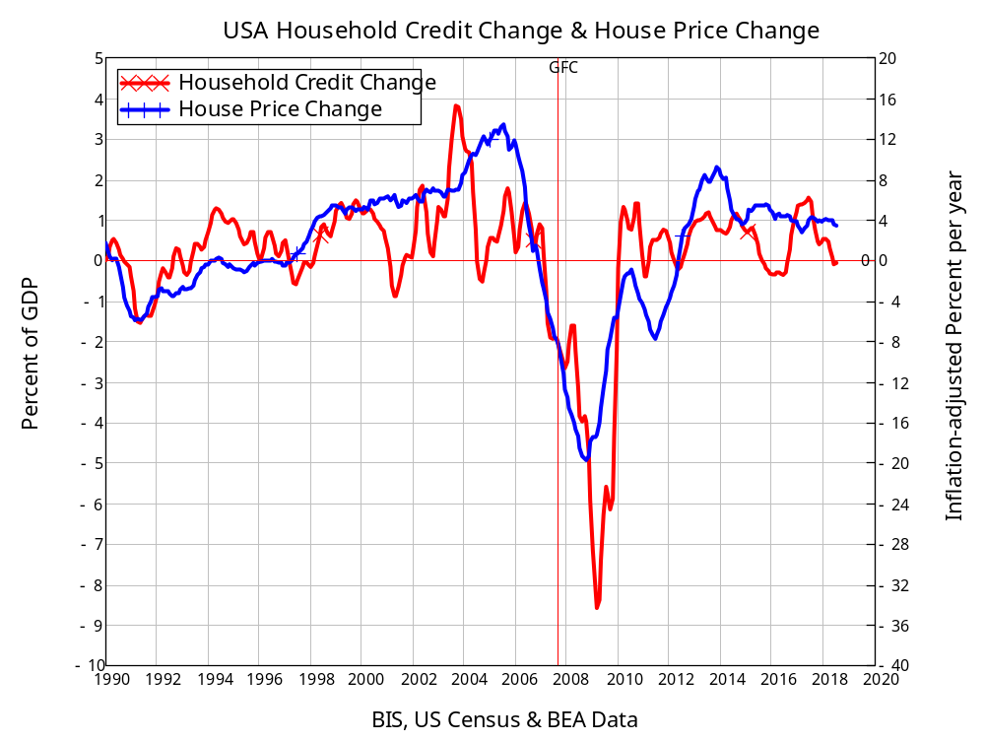
The Debt and Credit Trap
Correlation of change in household credit with real house price change is 0.71
Granger causality test confirms causation from change in household credit (acceleration of household debt) to change in inflation-adjusted house price index

Slide 16
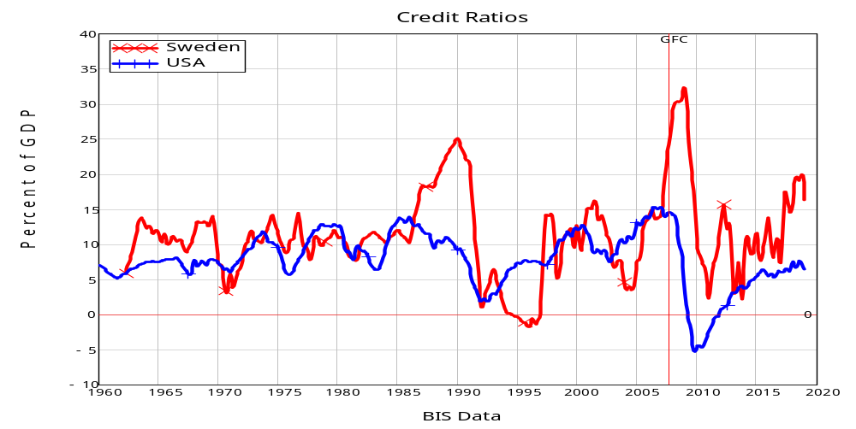
The Debt and Credit Trap
Sweden is more credit-dependent than the USA:

Slide 17
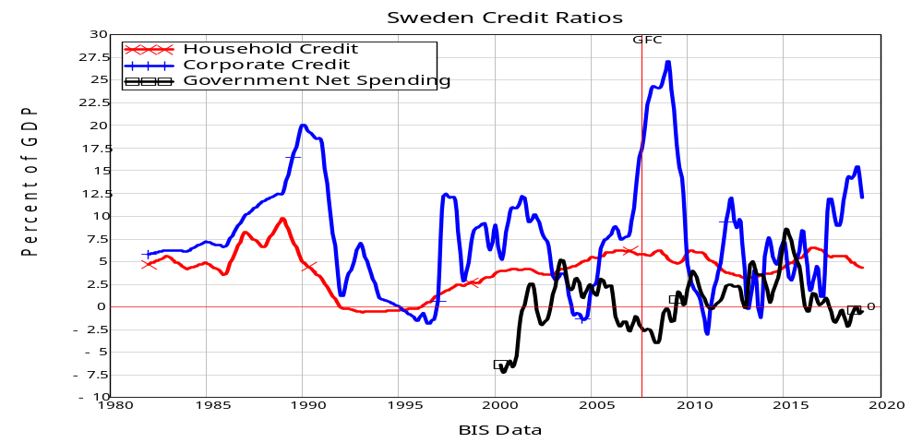
The Debt and Credit Trap
But at least most of the credit is for business rather than households

Slide 18
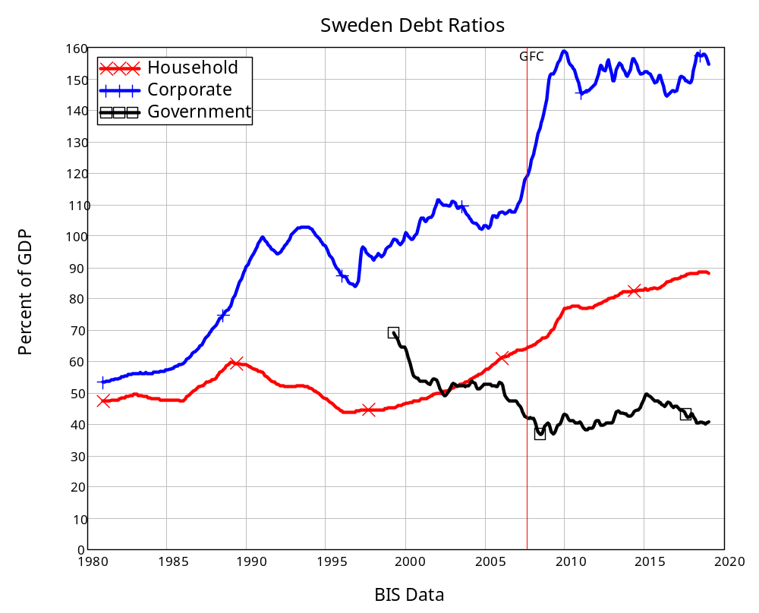
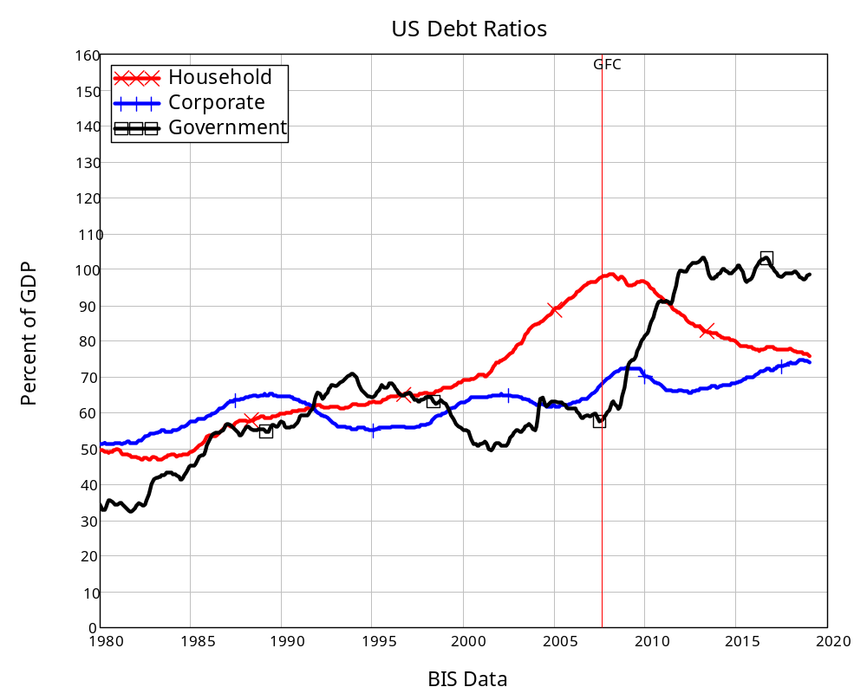
The Debt and Credit Trap
High credit levels result in much higher debt ratios than the USA

Slide 19
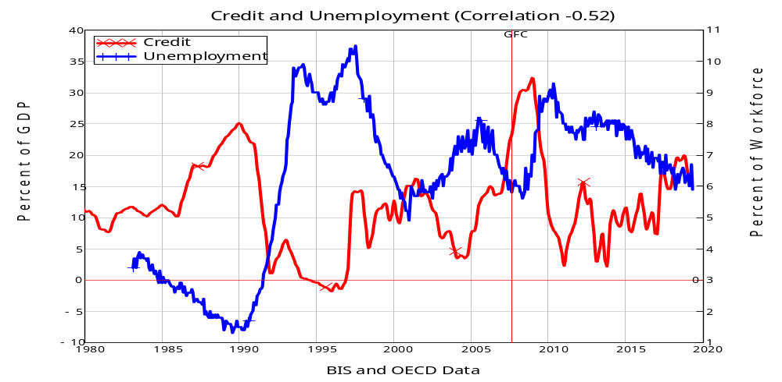
The Debt and Credit Trap
Similar, if weaker, credit→unemployment relationship in Sweden

Slide 20
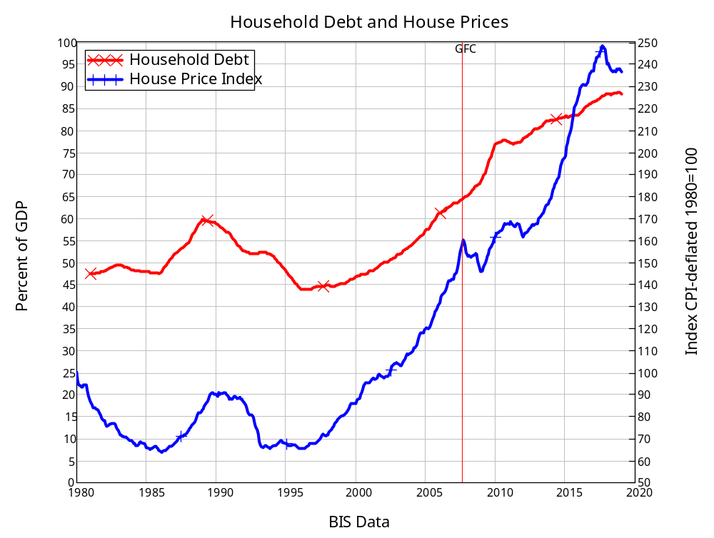
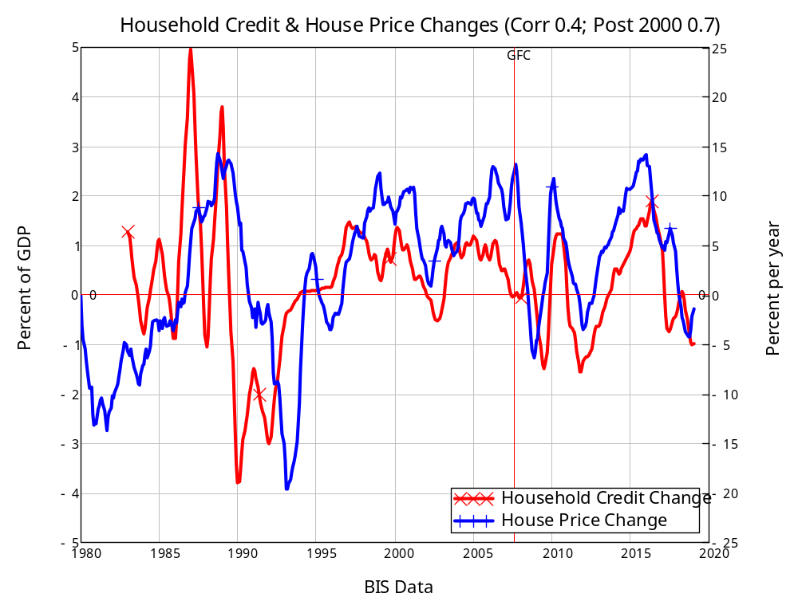
The Debt and Credit Trap
Similar household credit change→house price change relationship as well

Slide 21
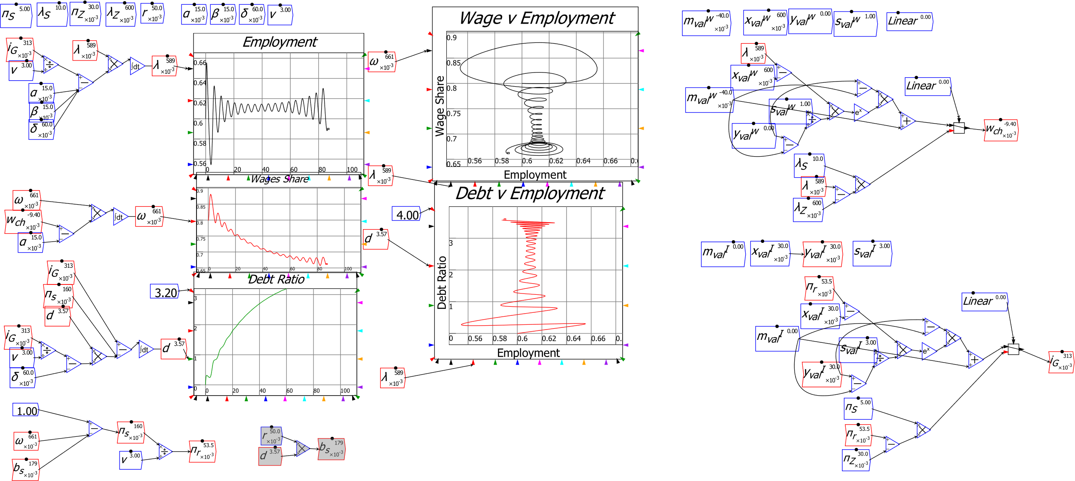

Support a new approach to economics: Minsky
Model economy as the monetary, dynamic, unstable complex system it actually is…

Slide 22
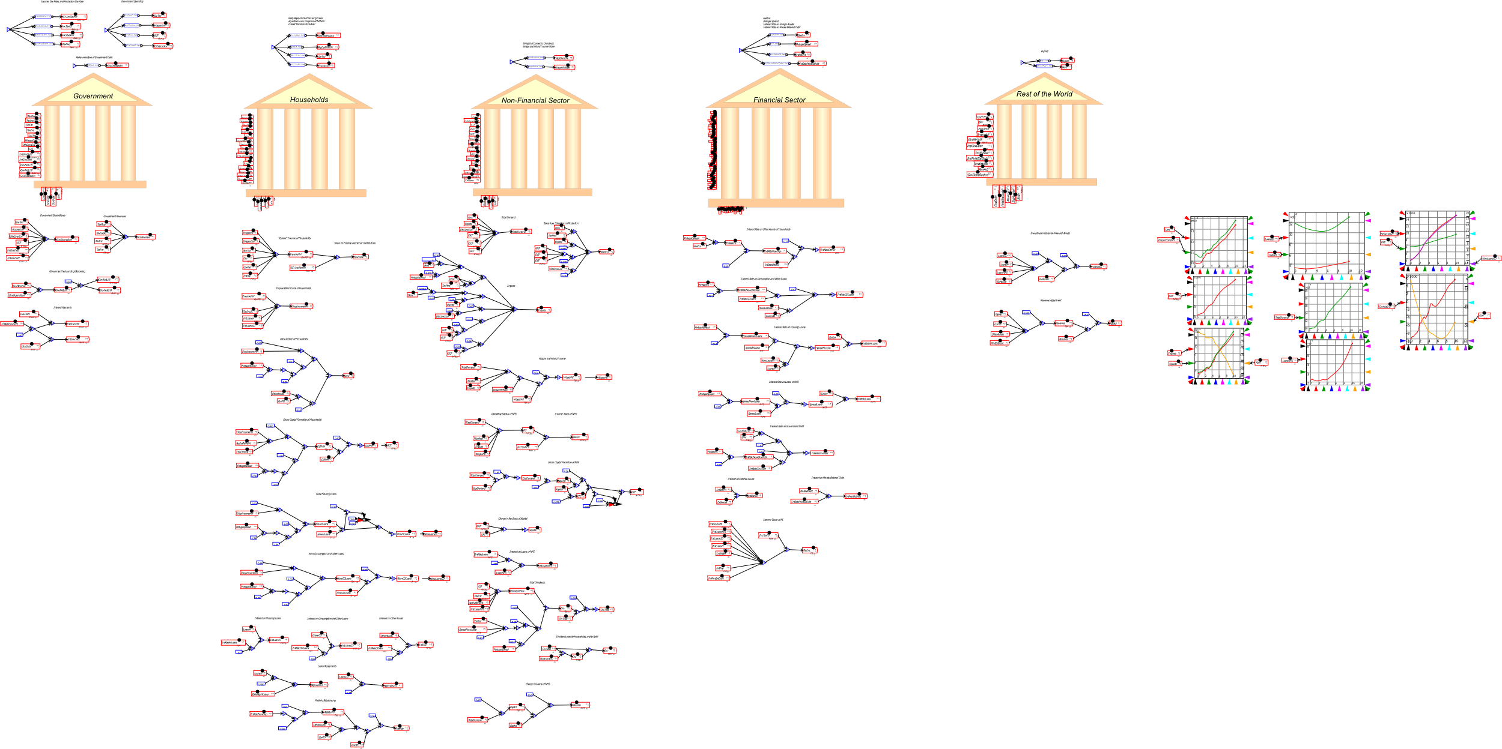

Support a new approach to economics: Minsky
General Dynamics: far more elaborate models can be built & simulated:
5 sector model of Portuguese economy (Pratas, Portuguese Statistical Office)

Slide 23

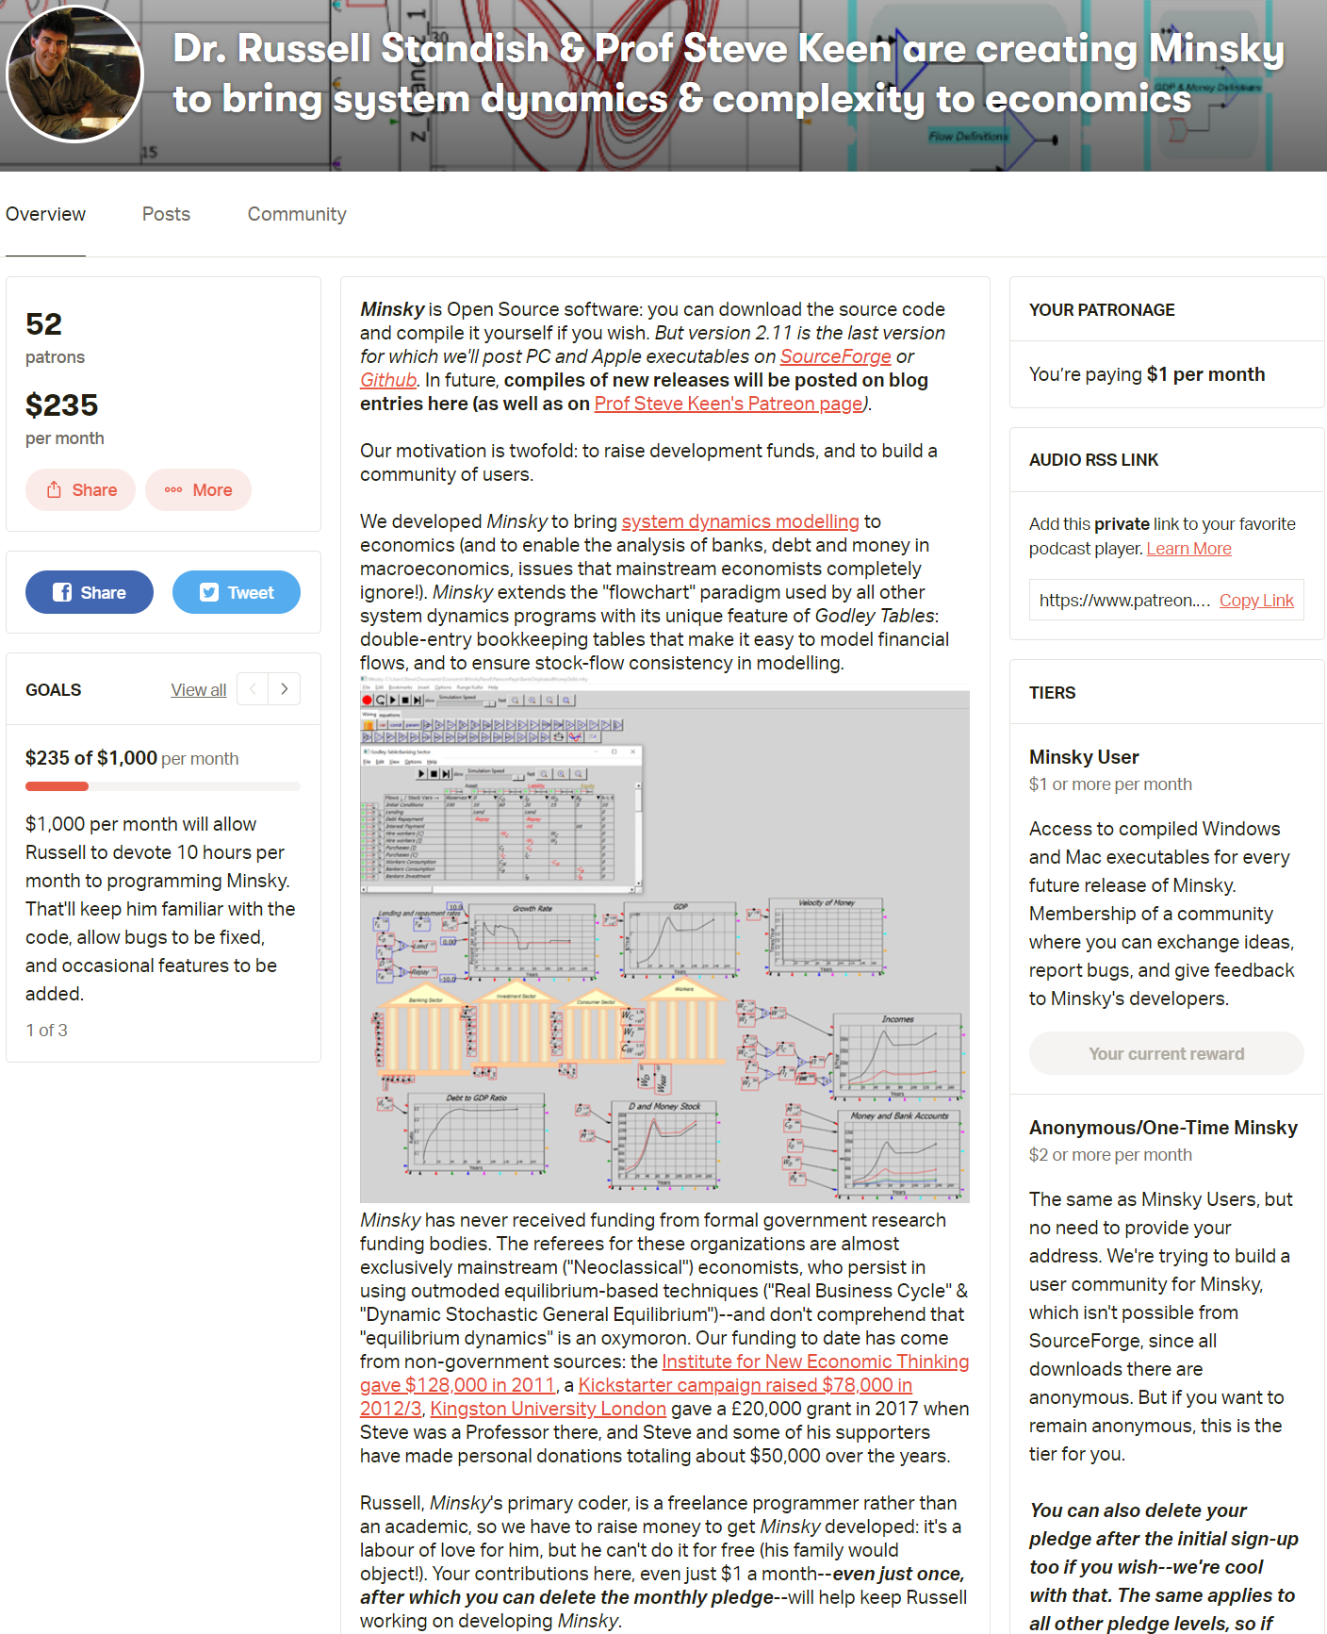
For more see https://www.patreon.com/ProfSteveKeen
Support Minsky at https://www.patreon.com/hpcoder/

