Slide 1
The e-krona project
The future of money
Stockholm, June 15, 2019
Carl Andreas Claussen
Senior advisor

Slide 2

Why an e-krona project?
What have we done/do we do?
When?

Slide 3
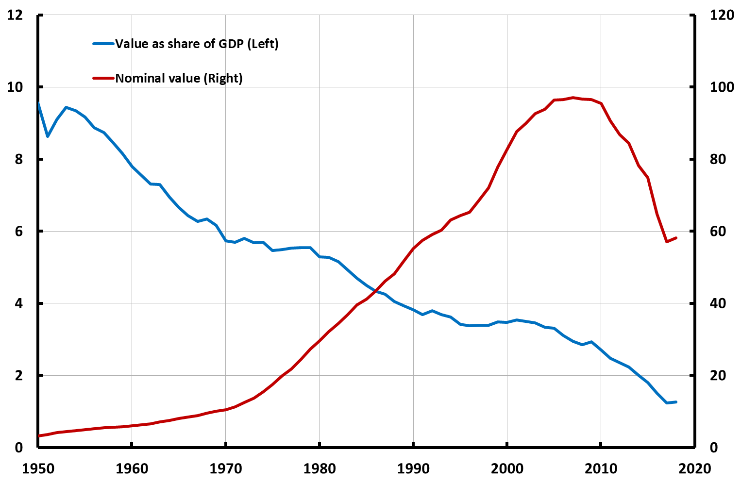
Cash is becoming marginalized in Sweden
Cash in circulation: Nominal value and as per cent of GDP
Per cent
SEK billion
Source: The Riksbank

Slide 4
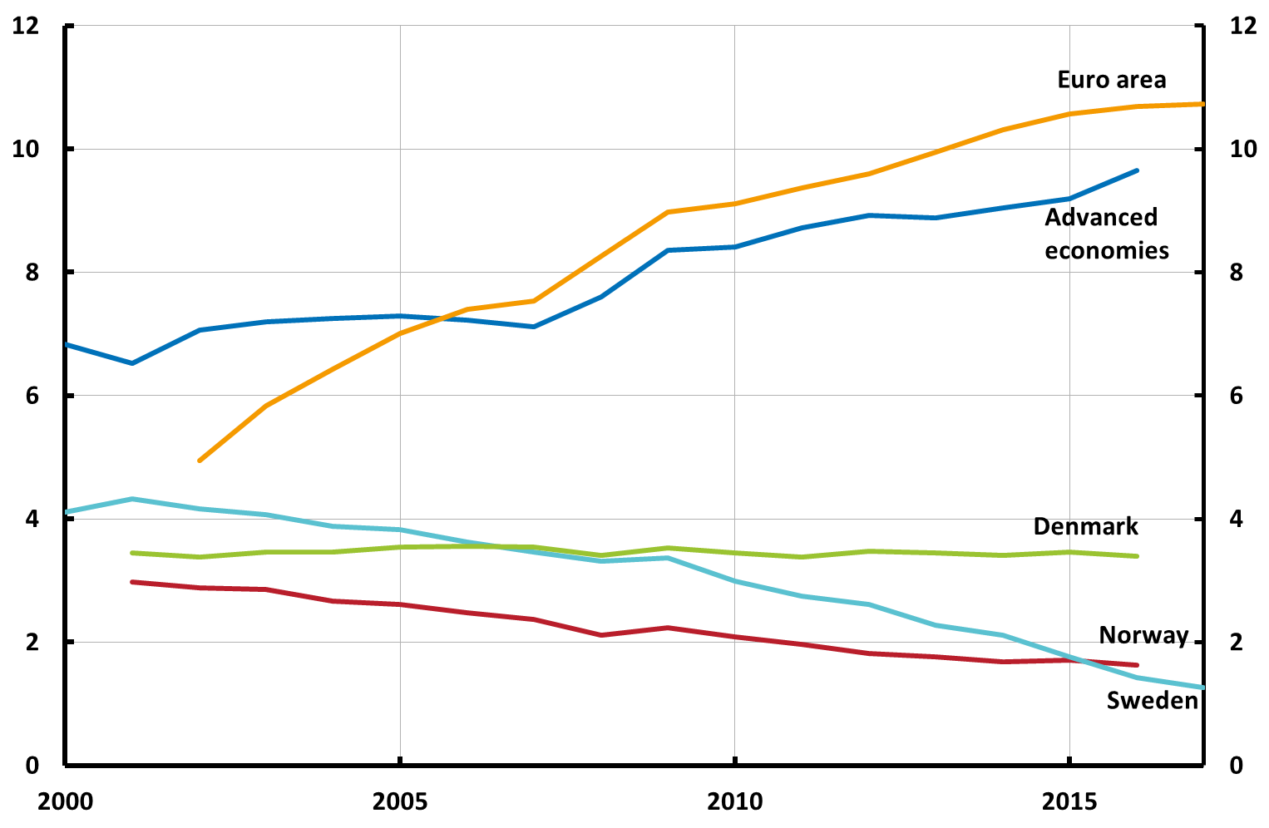
Sweden (and Norway) stands out internationally
Cash in circulation as per cent of GDP. Per cent

Slide 5
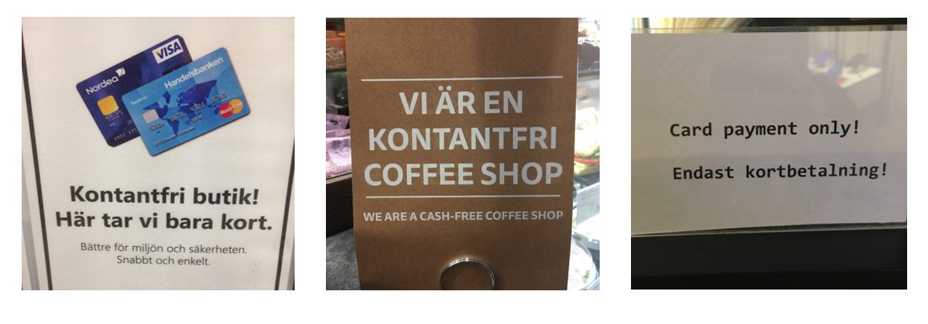
Half of Swedish retailers say they won’t accept cash in 7 years¹
1. Andersson, Hedman and Segendorf (2018), ”Cashless Society: When will Merchants Stop Accepting Cash in Sweden. A research model.” Memo.

Slide 6
Not the result of a decision to go cashless!

Slide 7
What if this continues?
Cash in circulation: Nominal value and as per cent of GDP
Per cent
SEK billion
?
Source: The Riksbank

Slide 8

What happens if we do nothing?
A new historical experiment
Some people can not pay
Will the system be robust?
Private marked provide a key public good, will that function?
What is a Swedish krona if cash disappears?

Slide 9
Do we need to issue digital cash?

Slide 10
Why an e-krona project?
What have we done/do we do?
When?

Slide 11
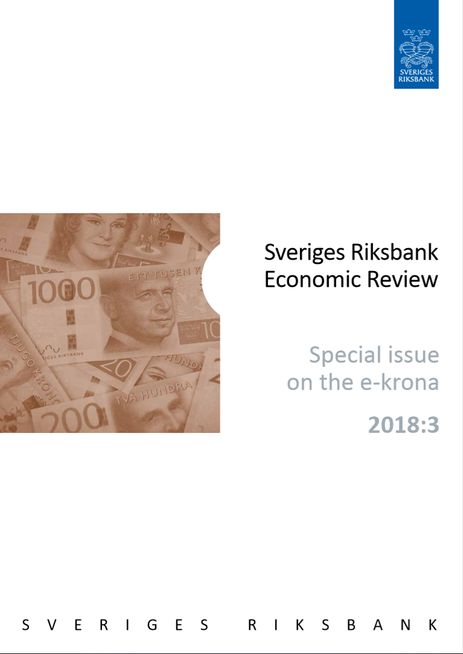
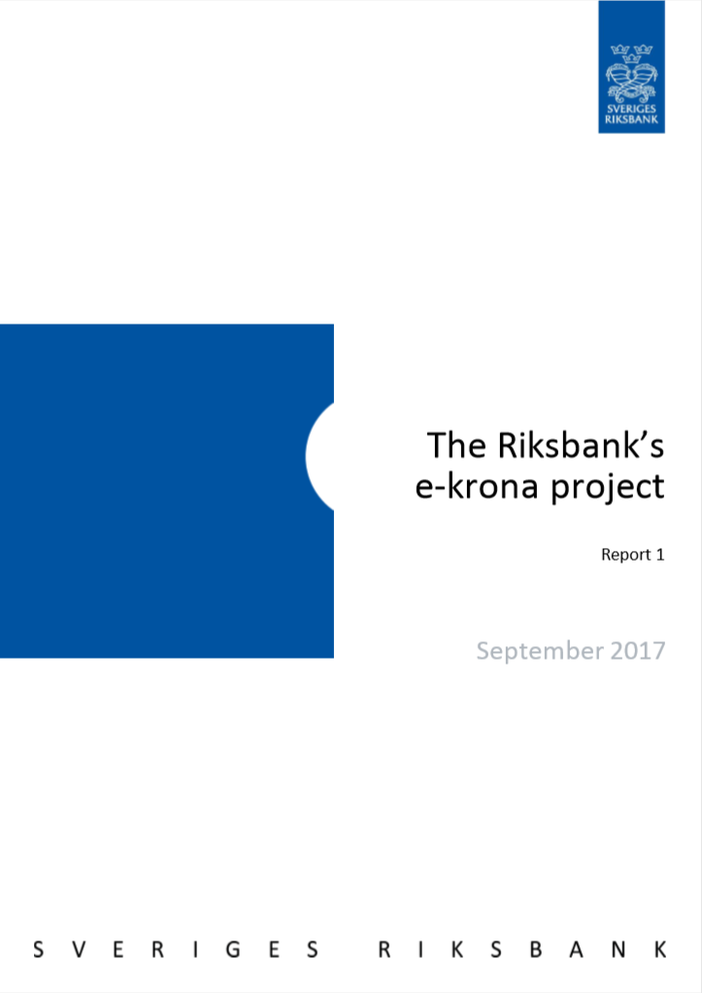
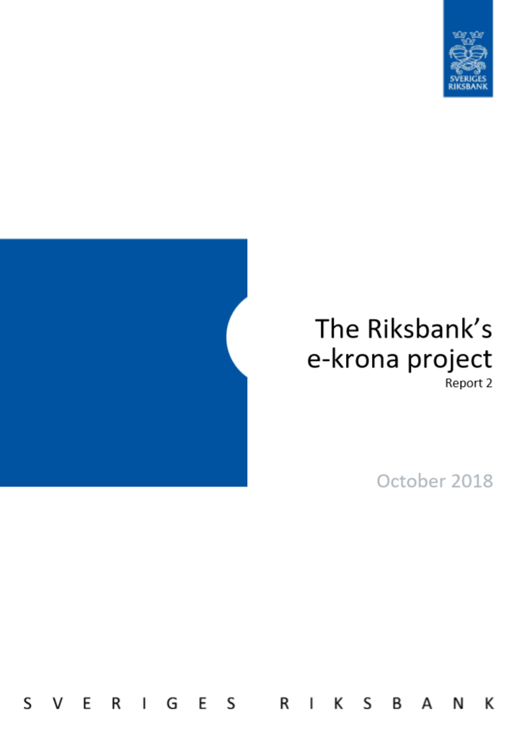
What have we done?
2017: ”Brainstorming”
2018: Deeper analysis
  What is an e-krona?
  What can it do
  Consequences
  Legal issues

Slide 12
What is an “e-krona”?
“Digital”
A claim on the Riksbank (as cash and reserves)
SEK
Value and/or account based
Available real time and “retail”
Can be interest‐bearing
→ A “CBDC”

Slide 13
Not replace, but complement

Slide 14
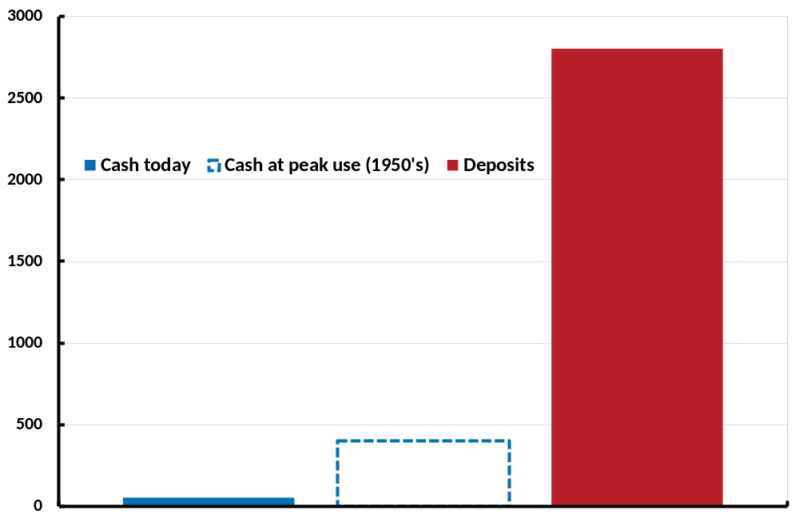
Not replace, but complement
Nominal value of cash and deposits

Slide 15
We have not concluded!
(Continue to analyze)

Slide 16
Some other takeaways so far
The e-krona ensures public access to central-bank money
It is an infrastructure/payment system?
  A national payment system that stands on its own feet
  Competition: Increase non-bank access to settlement services in central bank money
  Function as a platform for innovation
Consequences for monetary policy and financial sector and stability
  Depends on its features
Need political decisions
→ Further analysis and research needed

Slide 17
We are not alone…
“In circumstances where the
traditional approach to the provision
of central bank money –
in physical form to the general public
and in digital form to banks –
was altered by the disappearance of cash,
the provision of CBDC could bring
substantial benefits” BIS, 2018
”I believe we should consider the possibility
to issue digital currency. There may be
a role for the state to supply money to
the digital economy”
Christine Lagarde, 2018

Slide 18
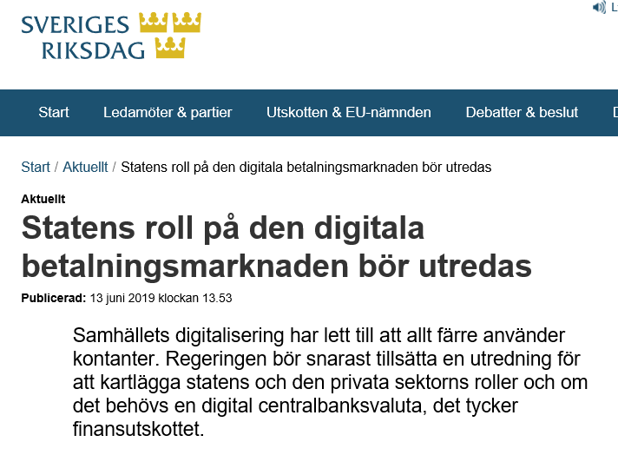

Slide 19
Why an e-krona project?
What have we done/what do we do?
When?

Slide 20
Further analysis + dialog
  Do we need an e-krona?
  Consequences
  Appropriate features
Testing of technical solutions
  Building a Pilot
→ No decision on issuance!

Slide 21
Why an e-krona project?
What have we done/do we do?
When?

Slide 22
No decision yet
(political decision)

Slide 23
Thank you!

Slide 24
Extra pictures

Slide 25
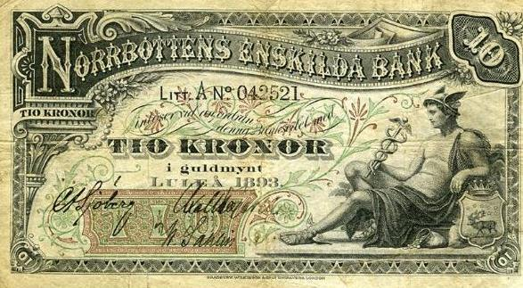

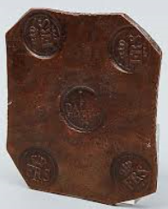
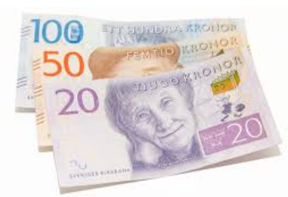


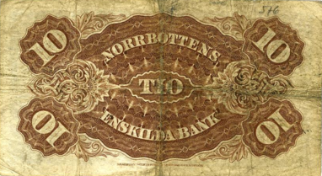
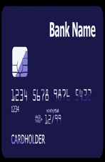
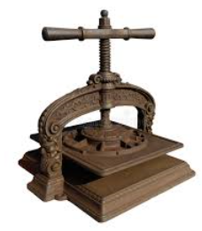

History repeats itself
Private digital money
Private banknotes
Metall coin
Fiat currency
Fiat digital currency
?
Notes:
So, to summarise and conclude: Money has come up in different forms through history and accross countries to facilitate daily life. Through history we see whow large technological developments are followed by technological changes in the way we pay. Often the first initiatives are private but sooner or later the state comes into the picture coordinating and making sure that the advantages are exploited fully.
350 years ago Stockholm Banco, that later became the Riksbank, was first to issue modern paper notes in Europé so that people no longer had to carry heave metal coin. This was made possible by the new printing technology. For long time central bank notes and privately issued notes coexisted. But there was a need for simplication and standardisation so the state eventually was given monopoly in the provision of cash to the public.
Now we face a new technological leap through the ditgitalisation of society. Once more, there are plenty of private initiatives but yet none from the state. We might once again be among the first to innovate through a new form of central bank digital currency that meets the needs of society adapting fiat currency to today’s technology.
Hirstorically we have seen that we obtain the best results when the Riksbank leads the way in cooperation with the market.

